Slide 1
DC Cameras are watching you!

Slide 2
Team members
Carly Kelly
Clementine Sraha
David Hoff
Yasir Omar

Slide 3
DC Facts
How big is Washington DC (in mi²)?

Slide 4
DC Facts
68.34

Slide 5
DC Facts
What is DC’s population?

Slide 6
DC Facts
702,455

Slide 7
DC Facts
How much in traffic fines did DC issue between 2016 & 2018?

Slide 8
DC Facts
1 Billion!

Slide 9
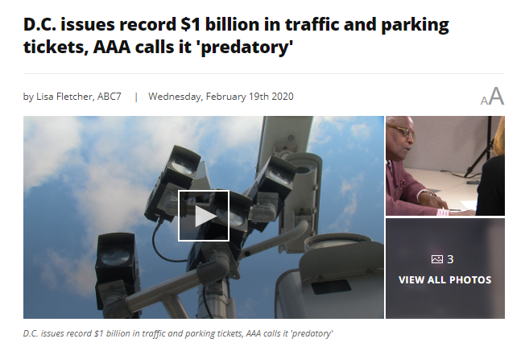
Motivation
“Townsend closely monitors the District's ticketing behavior. He says this is a money-making operation that can't prove these high fines have made anyone safer.
In fact, he says they haven't found any evidence that shows the amount of the fine modifies a motorist’s behavior.”
https://wjla.com/features/7-on-your-side/dc-issues-a-record-1-billion-in-traffic-and-parking-tickets

Slide 10
Hypothesis
Lower socioeconomic neighborhoods have a higher representation of traffic cameras.
Higher number of violations issued in those zip codes
More fines and revenue generated from those residents

Slide 11
Questions Asked & Why:
What is the correlation between issuing moving fines, in dollars, and the below socio-economic indicators:
Household income
Income per capita
Education level
Poverty level
How many moving violation tickets were issued for 2019?
How much, in dollars, did DC issue in fines for 2019?
What was the cost distribution of fines by zip code?

Slide 12
Questions and Data
Required Data:
Socioeconomic information by zip code
Number of active traffic cameras
Number of violations issued by camera
Fine dollar amount issued by camera
Data Sources:
American Census Survey (ACS)
Open Data DC
Google GeoCode

Slide 13
Data Cleanup and Exploration
Filter the census data for DC zip codes only
Identify moving violations issued by traffic cameras as opposed to ones issued by officers or parking meter attendants
There was no clear flag that identified violations issued by cameras
Violation records included an address but no zip code. We used geocode API to determine the zipcodes for over 1.1 million violations
The call ran for hours
We hit our geocode limit for the day so had to run it the next day
Carly tapped out her $200 google credit

Slide 14
Data Cleanup and Exploration
Dropped record with camera activity but no census data:
Household income value held filler values.
Memorials
Government buildings (JBAB)
Dropped zip codes with census information but no camera activity:
GWU
GTU
Catholic Univ

Slide 15
Data Analysis
Notes:
Bar charts properly illustrate the disparities between different zip codes in the amount of fines issued.
We felt data in which we compared traffic violations to socioeconomic factors was best represented by scatter plot as we wanted to see if there was positive or negative correlation.

Slide 16
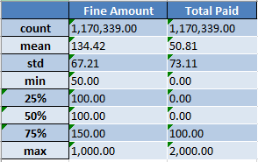
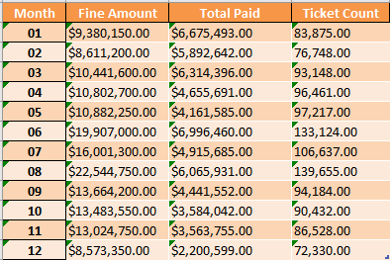
Exploratory Tables
Summary Statistics
Tickets and fine by month
Notes:
Summary Stats - count, max
Fines---- Max-August, Min-December
Total paid ---- Max -June, Min - December
Ticket ----Max-August, Min-December
Pattern seems to be seasonal

Slide 17
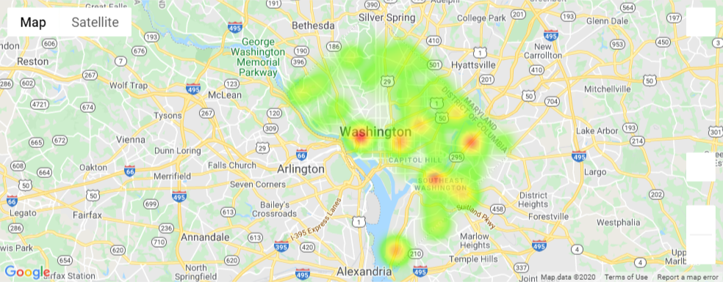
Heat Map of Total Violations Issued
Notes:
Hotspots - Foggy bottom, South east washington, North east washington
20020 has highest number of violations
20019, 20002

Slide 18
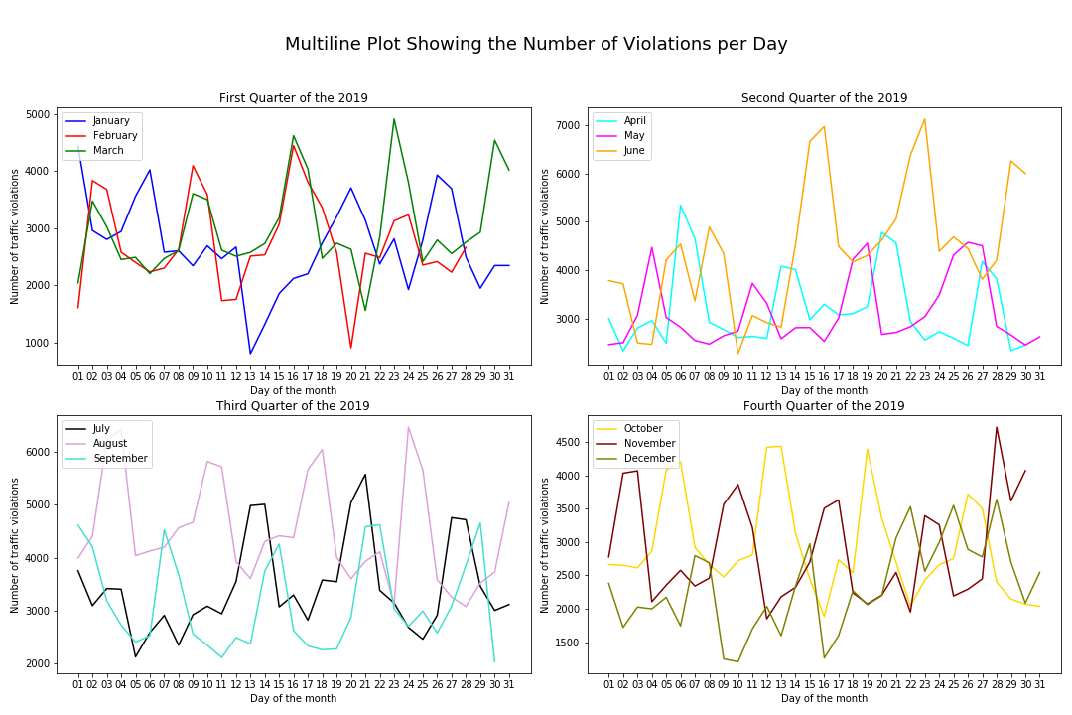
Notes:
No apparent pattern overall for each month
Seems to be cyclical by about 7 days
Jan 13th, Feb 20th were low
Jan13th there was a snow storm

Slide 19
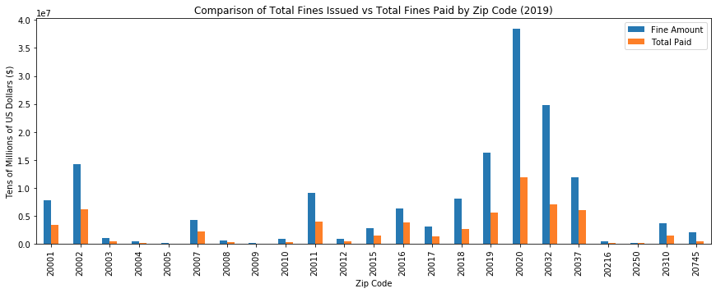
Notes:
20020 has the highest difference between Fine Amount and Total Paid

Slide 20
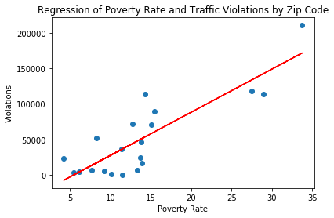
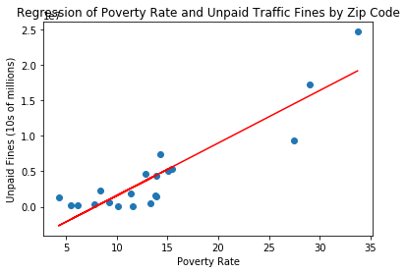
Data Analysis

Slide 21
Discussion
High correlation between poverty and violations
Possible correlation between Per Capita Income and violations
Lower than expected correlation between Minority Population % and violations

Slide 22
Post Mortem
Difficulties:
Very large data sets
Over a million violation records
Downloading CSV files from open data DC
ACS has census data up to 2018 only
Walking into this project with incorrect assumptions about data

Slide 23
Post Mortem
Additional questions:
Why are DC streets so bad?
Why are DC schools underfunded?
Who are the worst drivers MD, VA ,DC?

Slide 24
Final Question
“Townsend closely monitors the District's ticketing behavior. He says this is a money-making operation that can't prove these high fines have made anyone safer.
In fact, he says they haven't found any evidence that shows the amount of the fine modifies a motorist’s behavior.”
https://wjla.com/features/7-on-your-side/dc-issues-a-record-1-billion-in-traffic-and-parking-tickets

Slide 25
Questions?

